Slide 1
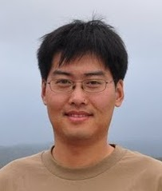
学术报告
报告题目：
Efficient Context-aware Scene Labeling with
Structured Models
报告摘要：
To provide a holistic understanding of a scene from an image or video, one promising approach is to reason about the entire image or image set as a whole, which enable us to capture contextual information and handle uncertainty in a principled manner.
This talk will focus on two key issues in this holistic approach to scene understanding. First, we discuss efficient modeling context relations at multiple semantic levels. In particular, we consider the semantic video segmentation task, and propose to incorporate foreground object information by jointly reasoning semantic labels of supervoxels, object instances and geometric relations between objects. The second challenge we address is the problem of learning contextual representation by studying the task of object co-detection. We present an approach to co-generating object proposals in multiple images, thus leveraging the collective power of multiple object candidates. I will conclude the talk with future research directions in efficient holistic scene understanding.
报告人： Xuming He
报告人简介：
Xuming He is a Senior Researcher at National ICT Australia (NICTA)
and also an adjunct Fellow at Australian National University (ANU).
He received the B.Sc. and M.Sc. degrees in electronics engineering
from Shanghai Jiao Tong University, and Ph.D. degree in computer science from the University of Toronto in 2008. He held a postdoctoral position at the University of California at Los Angeles (UCLA) before joining NICTA. His research interests include semantic segmentation, 3D scene understanding, visual motion analysis, and efficient inference and learning in structured models.
ANU personal webpage: http://users.cecs.anu.edu.au/~hexm/
报告时间：
2016年6月3日上午10:00--11：30，星期五
报告地点：
华中科技大学南一楼西203， 电信学院学术报告厅
欢迎各位师生参加！

